Slide 1
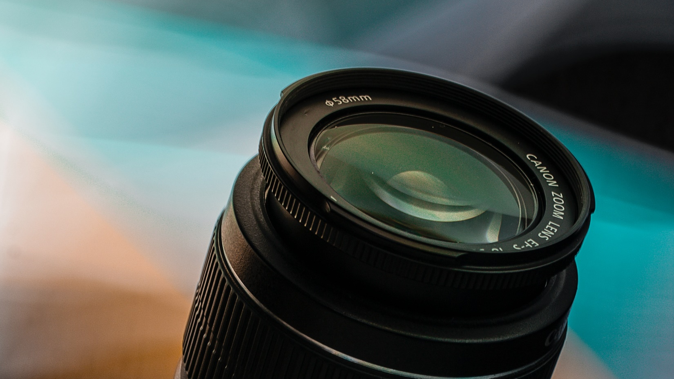
Velocity Prediction Base on 2D Vision
Team 15:
311512007 蔡馥宇
311512015 謝元碩
311605011 黃品振
310605024 陳祥曦
Notes:
Hi everyone. This is team 15. Our final project is Velocity Prediction Base on 2D Vision.
I am 謝元碩. And my teammates are 蔡馥宇 黃品振 陳祥曦.

Slide 2
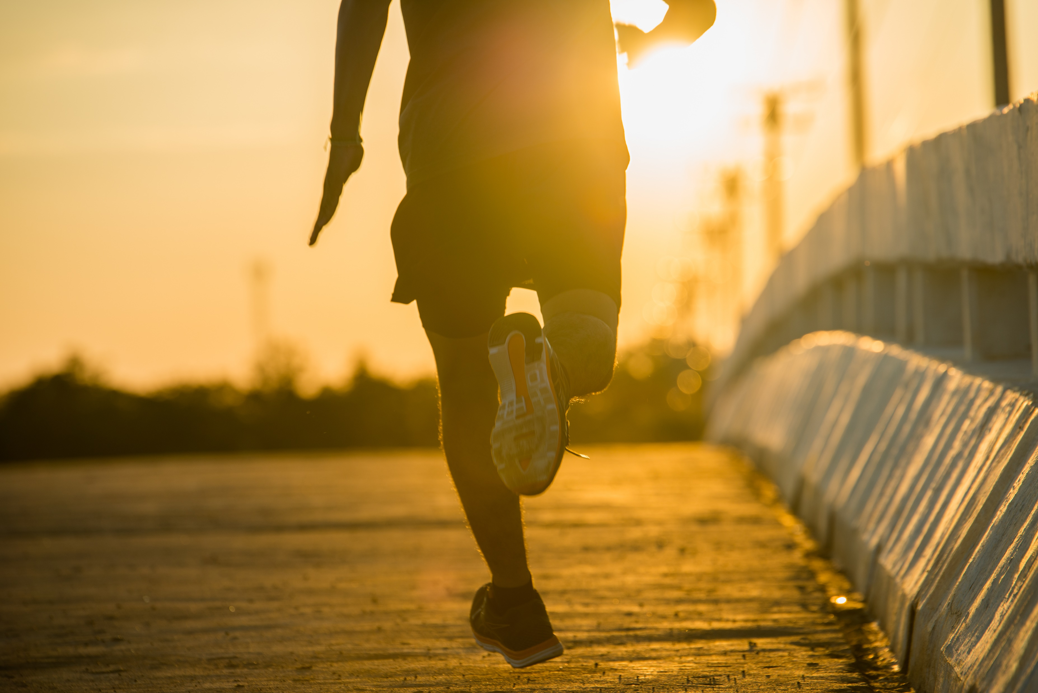
Goal
Predicting the movement speed of a specific object in a photo using only multiple 2D images.
We would like to develop a velocity prediction system that uses multiple photos containing people.
By analyzing the photos captured at different time points, we aim to calculate the average speed of people's movement.
Notes:
Our goal is to predict the movement speed of specific objects in 2D images using only an RGB camera. Therefore, we have developed a velocity estimation system to calculate the speed at which people move within the captured images. By analyzing the images at different time intervals in the video, we aim to calculate the average speed of people's movement.

Slide 3
Implementation Flowchart
Read Video Bag
Video info.
We use rosbag to record RGB images as a .bag file.
Rosbag is a functionality in ROS, and our .bag file includes all RGB images in each frame as well as frame times.
Read a bag file to perform all processes and get final result: Average Velocity.
A signal is designed to tell velocity calculation that it can do its work.
Save Frame Images
Begin image,
End image
Depth Estimation
Signal
Depth image,
RGB image
Velocity Calculation
Average Velocity
Notes:
We utilize the "rosbag" functionality in the Robot Operating System to record a video and save it as a ".bag" file. Rosbag enables camera recording, and the saved ".bag" file contains RGB images for each frame along with their corresponding timestamps.
The flowchart begins by reading the ".bag" file and extracting the necessary information for further processing. Then, the "Save Frame Image" step is performed to capture specific frames at desired time points. These images are then fed into the depth estimation module to obtain depth images. Finally, the average speed of the objects is calculated using the RGB and depth images.
Additionally, in the depth estimation part, we design a signal to notify the "Velocity Calculation" module to perform estimation after the depth estimation is completed.

Slide 4
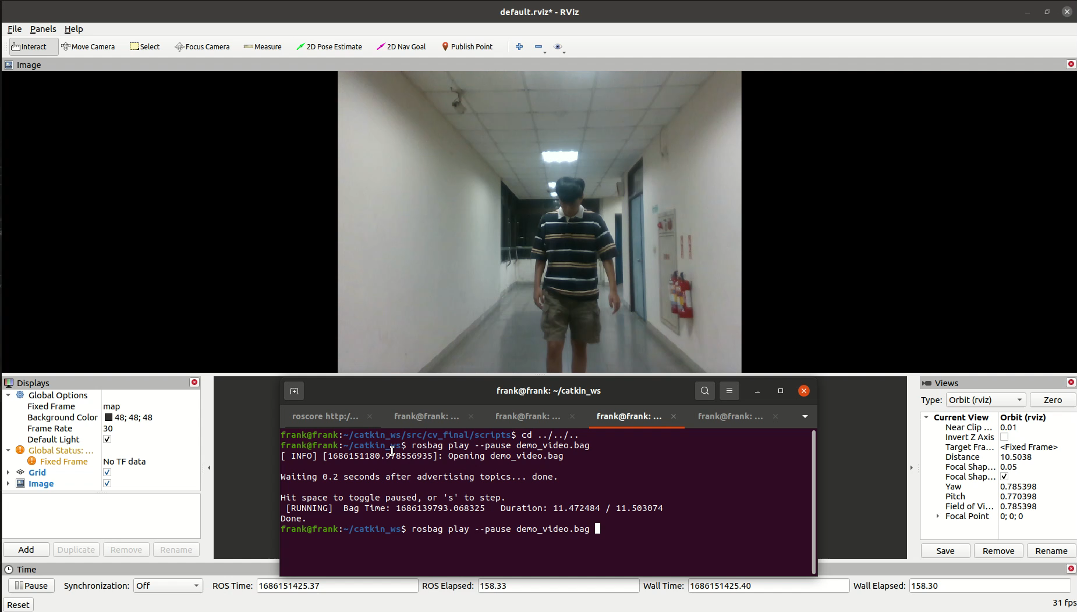
Rosbag Video
Notes:
Here we demonstrate the recorded video. We used a Realsense camera for recording and played back the video using rosbag. In the video, you can observe a person walking in a corridor.

Slide 5
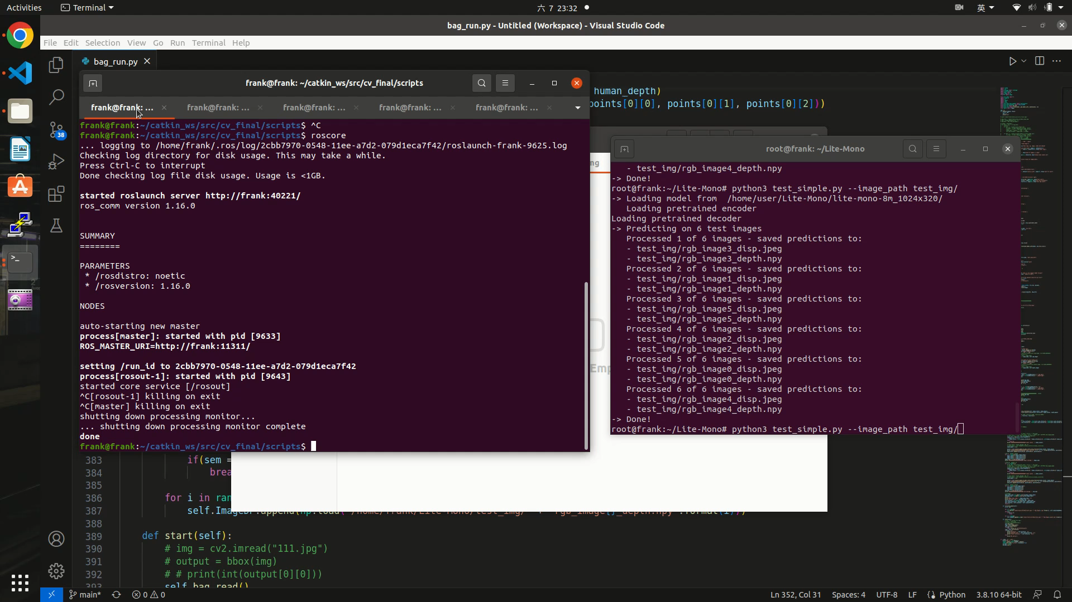
Demo Video
Notes:
Next, we will play our demo video.
First, run the first Python script to read the bag file and save specific frames from it.
Then, on the left side, this process enters the waiting state, while on the right terminal, execute the depth estimation module.
Next, generate depth images, like this photo.
Afterward, manually send a signal to the first script through the signal mechanism. This script will perform the final velocity calculation and display the results in the terminal.

Slide 6
Data Collection
Read Video Bag
Read a .bag file that recorded RGB video.
Record all RGB images of each frame and all frame times.
Use YOLOX to obtain the preceding three frames and the subsequent three frames that contain people in the image.
Save Frame Images
Notes:
Next, we will provide a detailed explanation of each step.
The previous steps primarily involve data collection. Firstly, we read the pre-recorded bag file to obtain the image information for each frame, including RGB images.
In the "save frame images" step, we save the RGB images for each frame from the bag file. Then, using YOLOX, we get the frames that contain people by extracting the preceding three frames and the subsequent three frames. These images will be fed into subsequent modules for depth estimation and calculations.

Slide 7
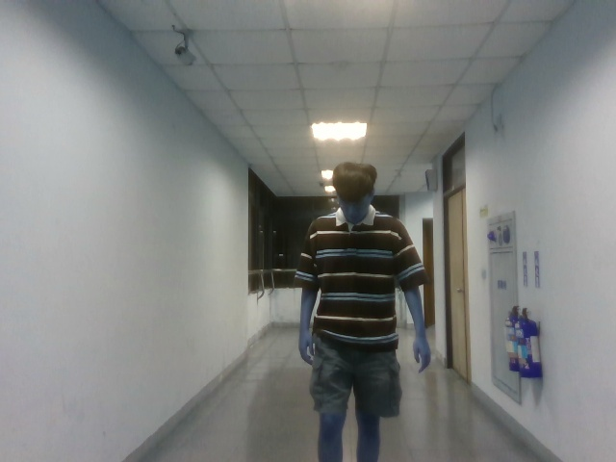
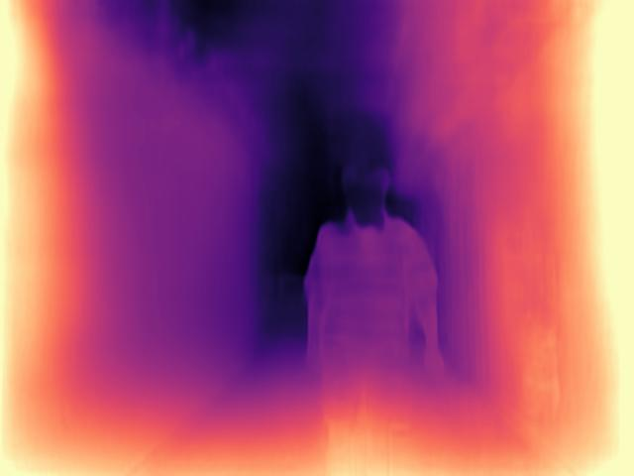
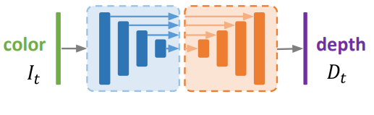
Monocular Depth: Deep Depth Estimation
Replace depth sensor with deep learning on regular RGB camera
This approach predict depth image with only one RGB input
Compared to point cloud from LIDAR, the monocular depth estimation provides more dense prediction
Low hardware cost for mid range depth sensor
Notes:
Our system rely on depth maps, which represent the 3D geometry of a scene.
Since depth sensors increase costs, we use Convolutional Neural Networks to predict the depth value of each pixel on a single image.
This approach create much denser measurements compare to regular 3D LiDAR

Slide 8
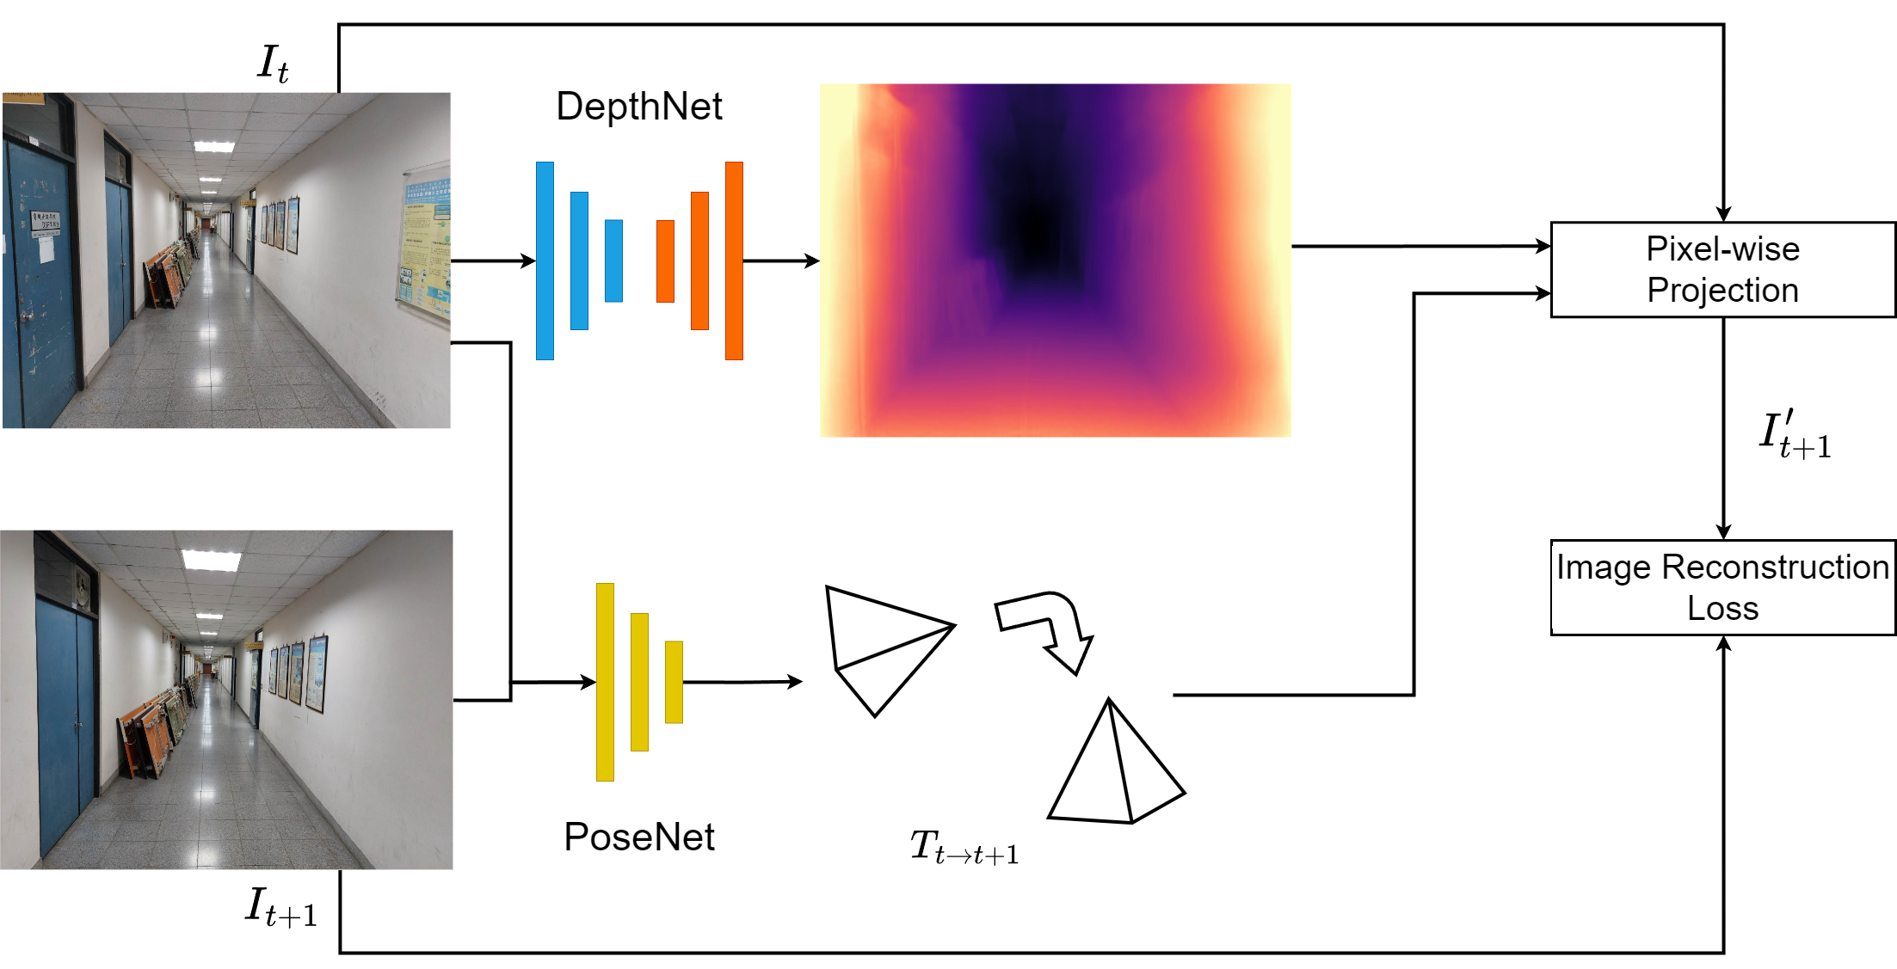
Self-supervised Learning for Depth Estimation
Use frames in videos as input
Don’t need depth for ground truth
The DepthNet estimates multi-scale inverse depth maps of the input image
The PoseNet estimates the camera motion between two adjacent frames
The outputs of both networks are then used to inverse warp the source views to reconstruct the target view
Notes:
Dataset with full depth annotation is hard to collect, using monocular videos for training an additional pose network is needed to estimate the motion of the camera
It learns to predict the pixel-level correspondence between pairs of images from monocular vedio

Slide 9
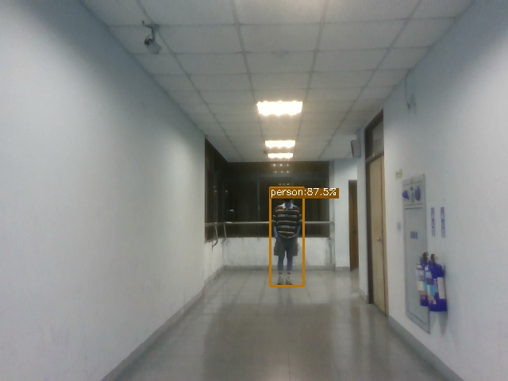
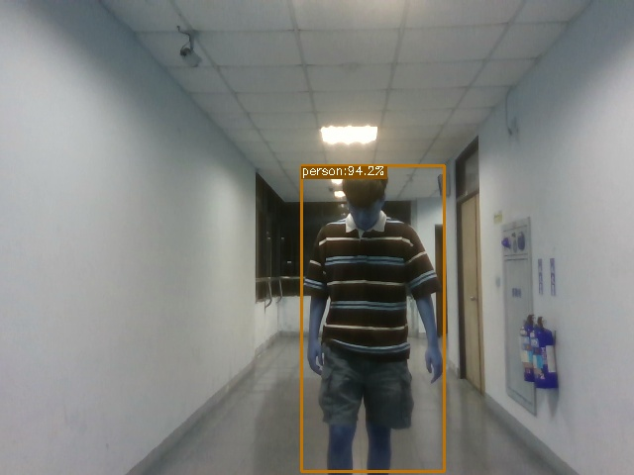

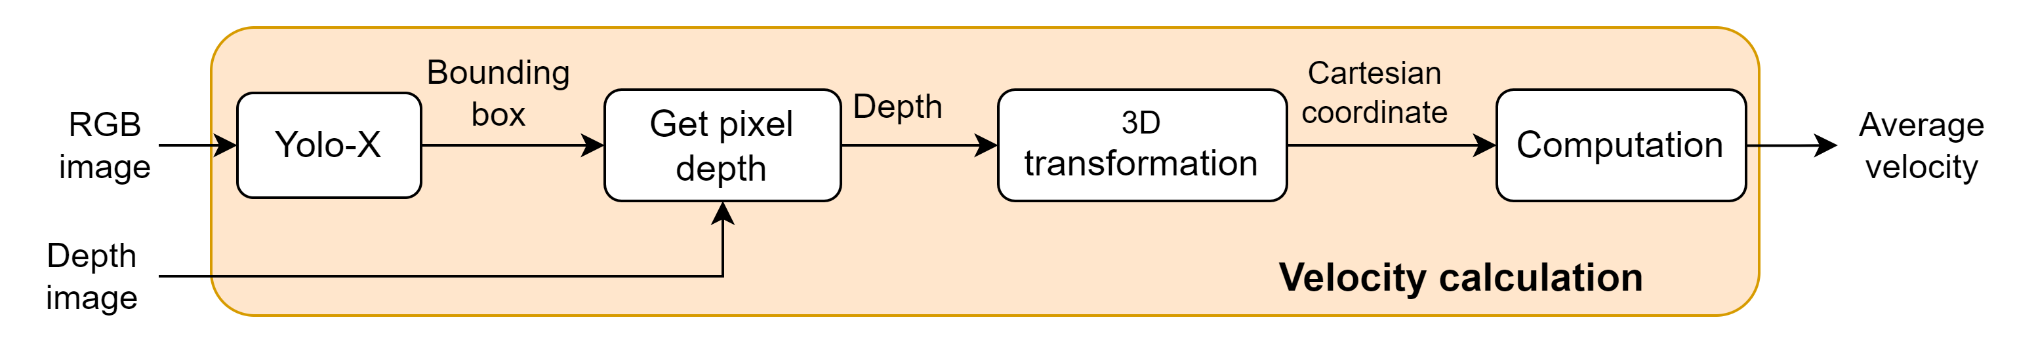

Velocity Calculation
Start
End
Use YOLO-X to detect people and get the bounding box in the image,
Grab the center of the bounding box as the representative piexl1 of the person, and get its depth value.
Because we have camera intrinsic (focal length, optical center), so the depth and 2D piexl are used as input, and converted to 3D coordinates by the pinhole principle.
Calculate the velocity of people's movement through 3d coordinates and their corresponding time.
Confidence Threshold : 0.85
Notes:
Our method utilizes YOLO-X, an advanced object detection algorithm, to detect people and obtain accurate bounding boxes in images. By leveraging camera intrinsic parameters, we can determine the depth value of individuals within these bounding boxes.
First, we use YOLO-X to detect and localize people in the visual data. we set the confidence threshold to 0.85 to avoid detect other things, this means that if YOLO detects other objects, but their confidence is lower than 0.85, YOLO won’t predict their bounding boxes. This model excels at accurately identifying objects and generating precise bounding boxes. Once we have the bounding boxes, we focus on the center pixel of each person's box and extract its depth value. Using the pinhole principle, we convert the 2D pixel and depth information into 3D coordinates.
With the 3D coordinates in hand, we proceed to analyze the movement of individuals. By comparing their coordinates at different time points, we can calculate their velocity, providing valuable insights into their motion patterns. This allows us to understand how people are moving in the scene.

Slide 10
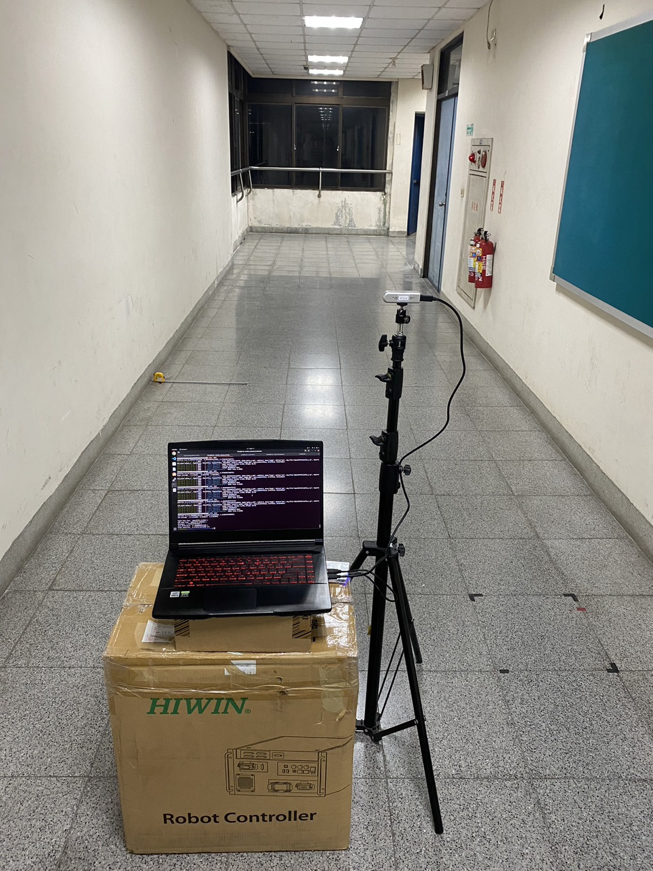
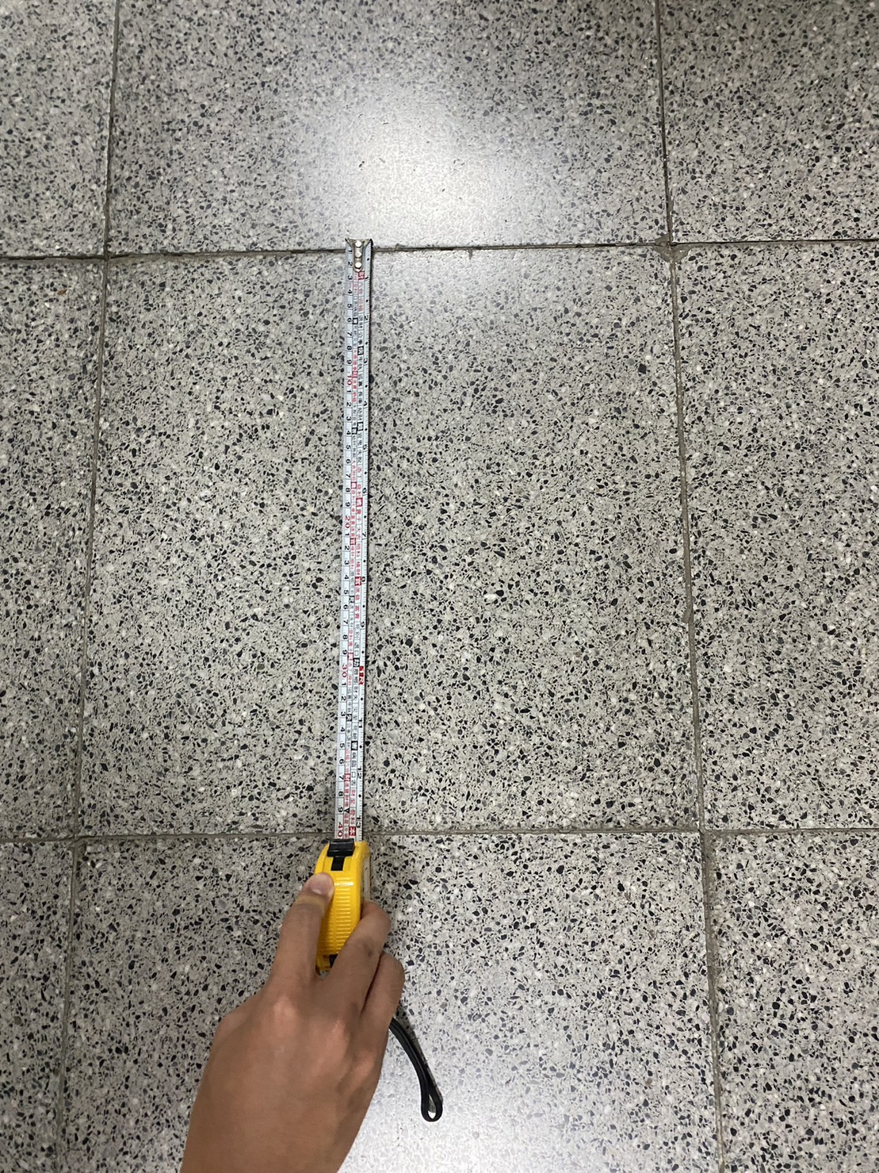
Experiment Results
Experimental environment
40cm
Notes:
This is our experimental environment, and the way we evaluate groundtruth distance is to measure how long a tile is, then count the number of tiles, then we can get the groundtruth distance. After we have groundtruth distance, calculating the groundtruth velocity will be an easy issue, all we have to do is to record the time the person pass through, then divide distance by time, then we can get the groundtruth velocity.

Slide 11
Experiment Results
Compare with groundtruth
 | Ours | groundtruth | error
Distance | 5.88m | 6.42m | 0.54m(8.4%)
Elapsed time | 11.46s | 11.46s | 0
Velocity | 0.51m/s | 0.56m/s | 0.05m/s(8.9%)
Notes:
This table shows the result compared with groundtruth. And we can notice that the error is about eight to nine percent, its not bad, but still have a long way to go. This is our presentation of final project, thank you!

Slide 12
Thank you

